Slide 1
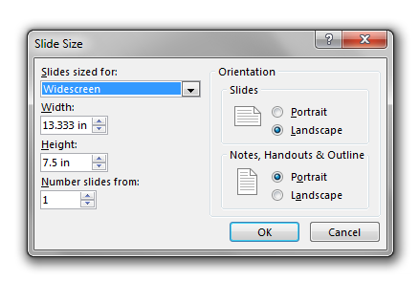
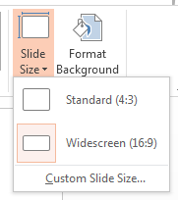
TITLE (size:20; bolded; spatiere: 1rand)
Authors an affilliation(size 14; italic, spatiere: 1 rand)
Text
Fig. 1. Reccommandation
1 slide
Landscape orientation
DO NOT insert video and audio files
Fig. 2. Apect ratio

